Slide 1







5th November 2020
n
p
Library
Gate driver
Keep components and wires on a 2mm grid when drawing
(set up by right-clicking page, grid and guides…)
+
Gate driver
Thermal camera
-
SD
DC bias
Multi-meter
Battery rail
UB20M voltage detector
Power analyser
Optical probe
Optical probe
Scope
Reset
Probe
$$V_{RECT}$$
$$Q_{1}$$
$$V_{IN}$$
V_{IN}
$$t$$
Probe
Probe
SMU
I_{IN}
+
−
$$V_{OUT}$$
Matt’s symbols
$$I_{IN}$$
Output
$$V_{R}$$
FDV302P
+
Battery
-
+ -
12 V 150Ah
LTC1540
Voltage detector
Power analyser
µC
Sens
UB20M
A
V_{SUPPLY}

Slide 2
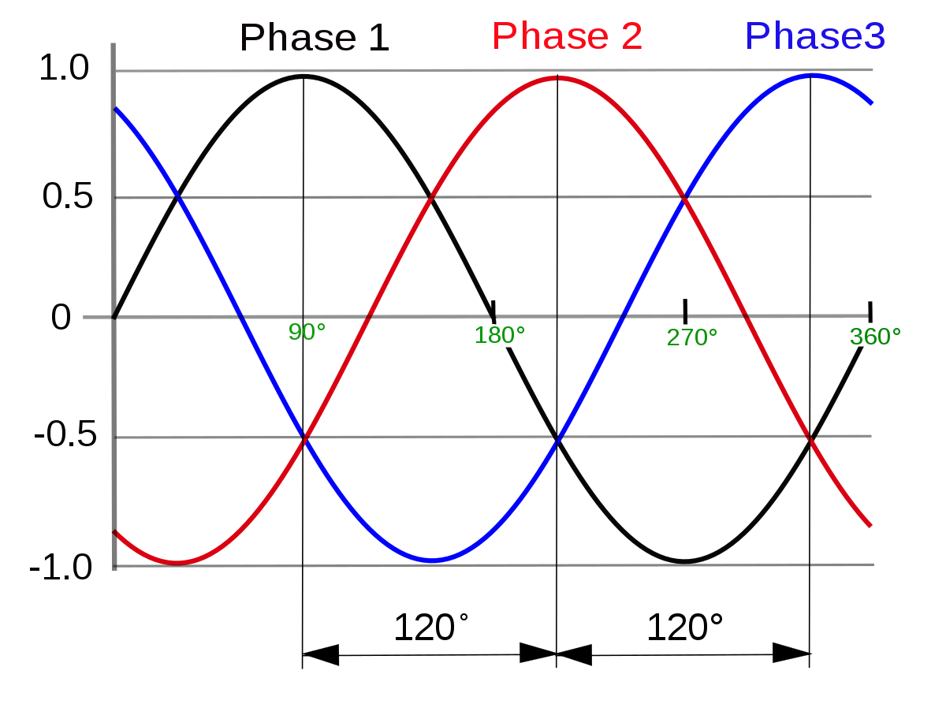
1
2
3
4
5
6

Slide 3

Hall effect current sensor
A
Arduino
5$Ω 300W$ Load dump
3 Phase Input
+
24V
Battery
-
To manual dump override switch
Optocoupler

